Slide 1
Lead Score Case Study

Slide 2
Problem Statement
X Education sells online courses to industry professionals. The company markets its courses on several websites and search engines like Google.
Once these people land on the website, they might browse the courses or fill up a form for the course or watch some videos. When these people fill up a form providing their email address or phone number, they are classified to be a lead. Moreover, the company also gets leads through past referrals.
Once these leads are acquired, employees from the sales team start making calls, writing emails, etc. Through this process, some of the leads get converted while most do not. The typical lead conversion rate at X education is around 30%.
Business Goal
X Education needs help in selecting the most promising leads, i.e. the leads that are most likely to convert into paying customers.
The company needs a model wherein you a lead score is assigned to each of the leads such that the customers with higher lead score have a higher conversion chance and the customers with lower lead score have a lower conversion chance.
The CEO, in particular, has given a ballpark of the target lead conversion rate to be around 80%.

Slide 3
Reading and Understanding Data
Data Cleaning
Data Analysis (Univariate and Bivariate analysis)
Creating Dummy Variables
Test Train Split
Feature Rescaling
Recursive Feature Elimination
Logistic Regression
Final Model
Model Testing
Lead Scores
Methodology

Slide 4
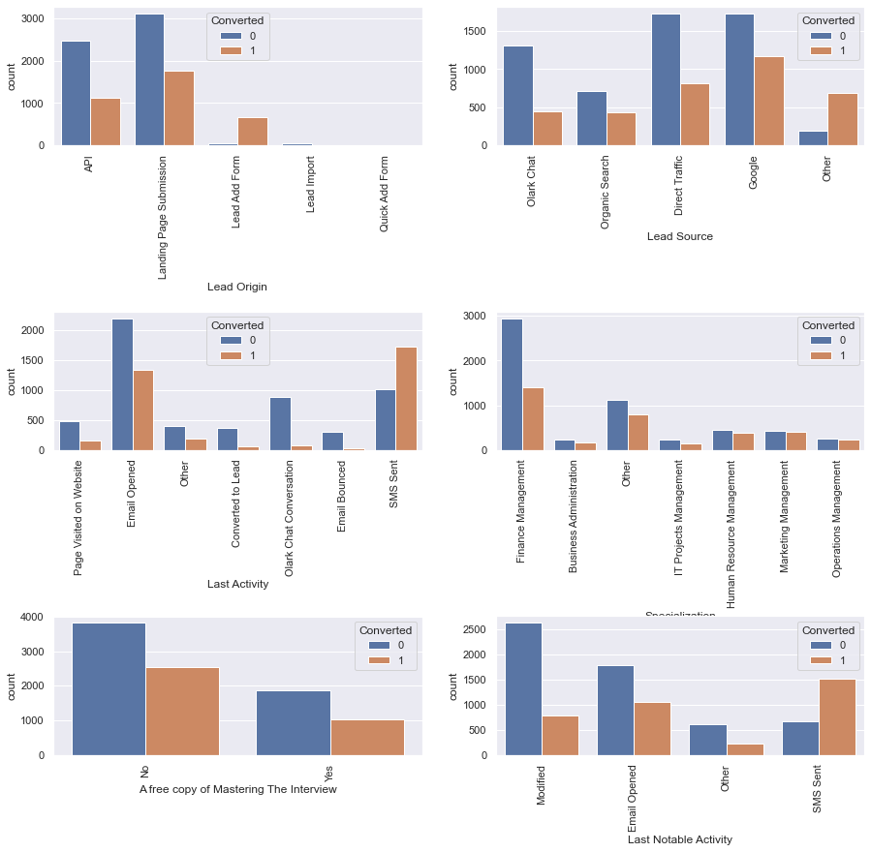
Bivariate Analysis With respect to Target Column Converted

Slide 5
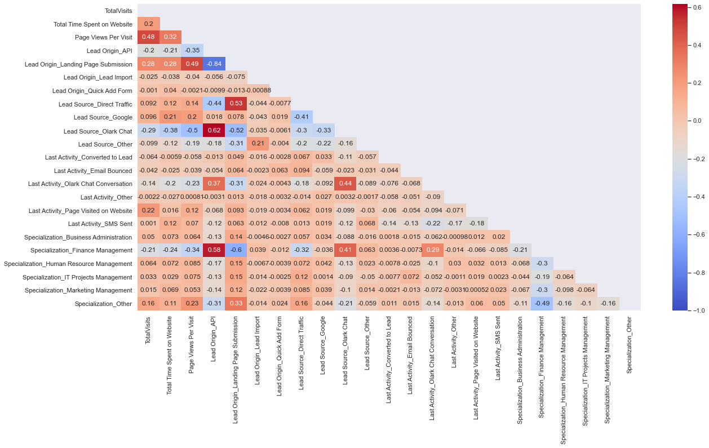
Correlation (Heat Map)

Slide 6
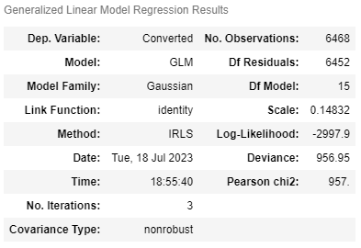
Final Model

Slide 7
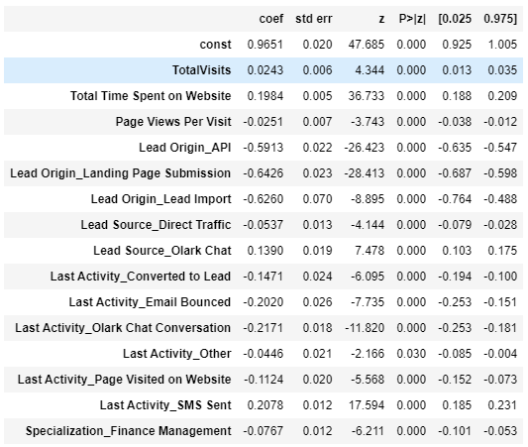
Coefficient Table of the Final Model

Slide 8
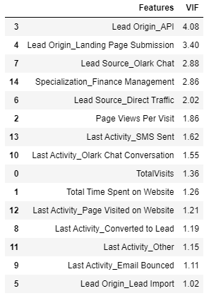
VIF Table for the Final Model

Slide 9
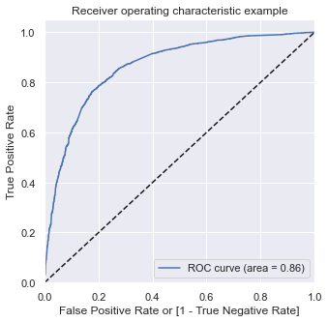
ROC Curve

Slide 10
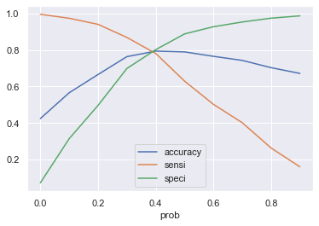
Plot for accuracy sensitivity and specificity for various probabilities

Slide 11
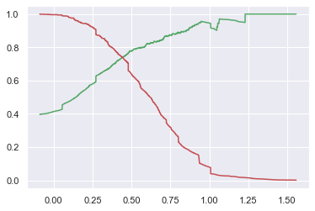
Thresholds: Precision and Recall Curve on Test Data

Slide 12
Confusion Matrix
 | N | T
N | 1275 | 402
T | 217 | 878
Accuracy : 77.66%
Sensitivity : 80.18%
Specificity : 76.02%

Slide 13
Conclusion
From the above analysis we can observe that the leads generated in the initial stage were high, but later only few of them become as a prospective customers.
out of all the variables observed, 'TotalVisits' , 'Total Time Spent on Website' , 'Page Views Per Visit' contribute most towards the probability of a lead getting converted.
Focusing on converted leads. it is vital to extract the right information needed for the improving the conversion rate.
Frequent follow-ups with the prospective customers and the leads will make the conversion rate high.

